Slide 1
Insurance in The Age of the Climate Crisis How the Insurance Industry can drive Climate Adoption
Dr. Louis Weimer
Louis.Weimer11@gmail.com

Slide 2
Caveat
All opinions expressed here are my own and do not reflect any official positions or communication from organizations with which I am affiliated

Slide 3
Outline
1.) State of the Home Insurance Market and Catastrophic Weather
2.) Causes of the Home Insurance Crisis
3.) Climate Change’s Impact on the Home Insurance Market
4.) Potential Solutions
5.) Concluding Thoughts

Slide 4
Causes of the Home Insurance Crisis
i.) Climate Change (focus)
ii.) Socioeconomic (inflation, house appreciation, migration to catastrophe prone areas)—pick up this thread in concluding thoughts
iii.) regulatory (e.g., Florida making it too easy to claim damage)
Note: Each of these interacts with the others

Slide 5
State of the Home Insurance Market
Premia are rising across the country. In 2024 Louisiana rates increased on average 24% to ~$8,000/year.
Florida rates will likely reach $12,000/year by 2025
Insurers leaving high risk states en masse (see Florida, California)
Source: National Association of Realtors
https://www.nar.realtor/magazine/real-estate-news/states-where-home-insurance-costs-are-surging-highest
St. Louis Federal Reserve
https://fred.stlouisfed.org/series/PCU9241269241262
https://themortgagereports.com/112679/states-surging-home-insurance-costs

Slide 6
State of the Catastrophic Weather
Forest fires are burning more area each year
(Source: “Global Trends of Forest Loss Due to Fire From 2001 to 2019”, Tyukavin et al., 2022)
Atlantic hurricanes are generally more frequent and more severe
(Source: Colorado State University, Department of Atmospheric Science, Tropical Meteorology Project)
Severe Convective Storm Damage is increasing on average 8.9% a year (though mostly driven by exposure)
Source: Aon

Slide 7
Climate Change’s Impact on Home Insurance
High level overview of insurance pricing
i.) Because of climate change, past no longer predicts future
a.) hurricanes, scs, tornadoes all more severe than in the past
b.) movement to cat prone areas— hurricane, WUI
iii.) Inadequacy of traditional actuarial methodologies

Slide 8
Climate Change’s Impact on Home Insurance Insurance Pricing 101
Money Comes in premium
Money Goes out in claims

Slide 9
Climate Change’s Impact on Home Insurance Insurance Pricing 101: Unstable Aggregate Claims In a warming world, Past no Longer Predicts Future
Year 1
Year 2
Premium | Claim
$100 | $0
$100 | $300
$100 | $0
$100 | $0
$100 | $0
$100 | $0
$100 | $700
$100 | $0
$100 | $0
$100 | $0
Total
$1,000 | $1,000
Premium | Claim
$100 | $0
$100 | $0
$100 | $400
$100 | $0
$100 | $0
$100 | $800
$100 | $0
$100 | $0
$100 | $0
$100 | $0
Total
$1,000 | $1,200

Slide 10
Climate Change’s Impact on Home Insurance Insurance Pricing 101: Harder to Match Price to Risk
No Differentiation
Premium | Claim
$100 | $0
$100 | $0
$100 | $400
$100 | $0
$100 | $0
$100 | $800
$100 | $0
$100 | $0
$100 | $0
$100 | $0
Some Differentiation
Premium | Claim
$75 | $0
$200 | $300
$75 | $0
$75 | $0
$75 | $0
$75 | $0
$200 | $700
$75 | $0
$75 | $0
$75 | $0
Max differentiation
Premium | Claim
$50 | $0
$200 | $300
$50 | $0
$50 | $0
$50 | $0
$50 | $0
$400 | $700
$50 | $0
$50 | $0
$50 | $0
We can think of this as a regression problem
Chronically underpredicting high-risk policies shifts the burden of risk to lower risk policies

Slide 11
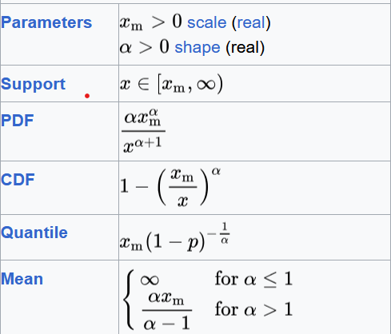
Climate Change’s Impact on Home Insurance Several Factors Hamper our ability to Match Price to Risk
Regulatory Restrictions on Advanced Algorithms
Machine Learning algorithms can match price to risk much better than traditional actuarial methods
Insufficient Actuarial sophistication
We need to better understand climate impact and home hardening
See Stand Insurance, Actuarial Climate Index
Heavy Tailing of Risks

Slide 12
Private Solutions
Home Hardening

Slide 13
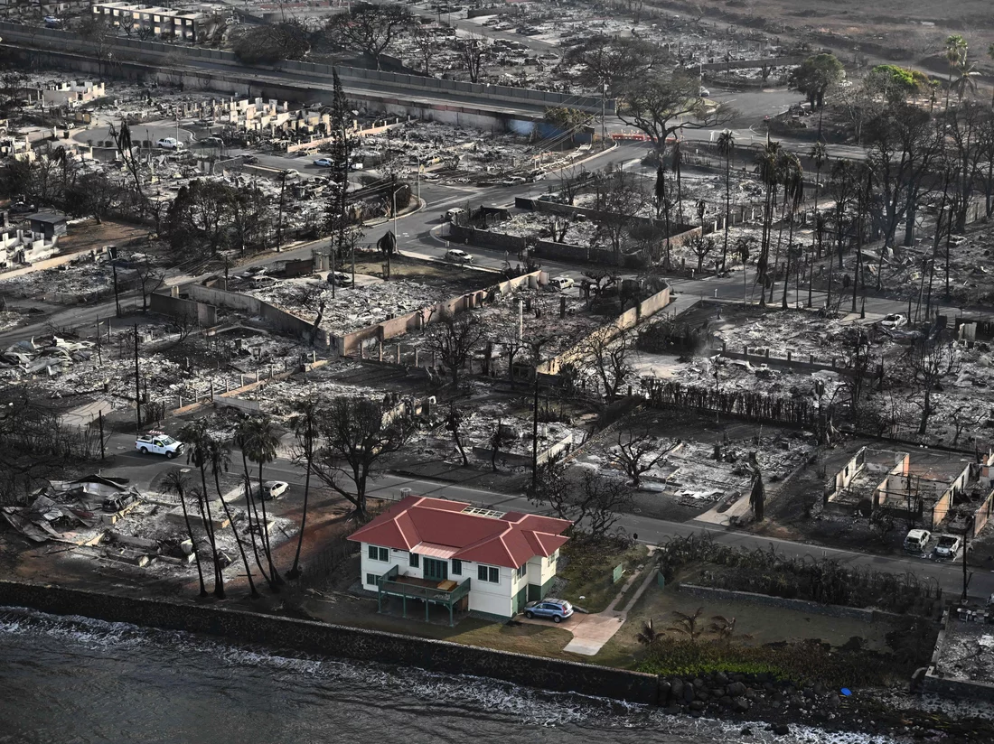
Private Solutions
Home Hardening: Fire
Roof Materials
Wall Materials
5 feet of space from flame fuel
Screen Vents
Ember Seals
Home in Lahaina fire. Source: NPR

Slide 14
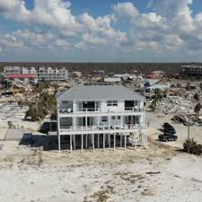
Private Solutions
Home Hardening: Hurricane
Roof Materials
Roof Connections
Flood Prevention (sealing, drainage)
Robust Windows and Doors
Stilts
Home in Mexico Beach, Florida, after Hurricane Michael. Source: ABC News

Slide 15
Private Solutions
Home Hardening
What do all these home hardening solutions have in common? They’re expensive to do fully. Average homeowner probably can’t spend tens of thousands of dollars without sufficient support or motivation

Slide 16
Private Solutions
Community Hardening
Harder to predict, more limited upside. Conditional on building in certain location, there’s always going to be a risk
Palisades fire examples

Slide 17
Private Solutions
Insurance Company Towns
Partnership between Insurance and Property Development to build resilient communities
Probably already happening

Slide 18
Private Solutions
Japanify Home Building
Cheaper Materials
Easier Reconstruction (Modular homes)
Significant Overlap with tiny home movement
Would require radical rethinking of American economic system

Slide 19
Public Solutions
Encourage Home Hardening
Allow for more Advanced Pricing Methodologies (more on this later)
Restrictions on where to build new homes
a.) disincentivize migration to CAT-prone states
b.) disincentivize construction in CAT-prone areas—next to beach, in WUI

Slide 20
Bringing it all Home: How Insurance Can Incentivize Climate Resilience
Homeowners will invest in home hardening when cost of doing so is less than the money they will save in Insurance premia:
Discount From Home Hardening
Cost of Home Hardening
>

Slide 21
Bringing it all Home: How Insurance Can Incentivize Climate Resilience
Homeowners will invest in home hardening when cost of doing so is less than the money they will save in Insurance premia:
Discount From Home Hardening
Cost of Home Hardening
>
Higher Premia a.) make home hardening discounts more attractive, and b.) disincentivize migration to areas that require home hardening investments

Slide 22
Bringing it all Home: How Insurance Can Incentivize Climate Resilience
Homeowners will invest in home hardening when cost of doing so is less than the money they will save in Insurance premia:
Discount From Home Hardening
Cost of Home Hardening
>
Make home hardening discounts more attractive
Someone paying $10,000/year in premia is less likely to invest in home hardening than someone paying $20,000 if they receive appropriate premia discounts
See Stand Insurance for example

Slide 23
Bringing it all Home: How Insurance Can Incentivize Climate Resilience
Homeowners will invest in home hardening when cost of doing so is less than the money they will save in Insurance premia:
Discount From Home Hardening
Cost of Home Hardening
>
Disincentivize building in areas that require home hardening investments
If Insurance is priced correctly, building homes in WUI/beachfront should be expensive

Slide 24
Bringing it all Home: How Insurance Can Incentivize Climate Resilience
Homeowners will invest in home hardening when cost of doing so is less than the money they will save in Insurance premia:
Discount From Home Hardening
Cost of Home Hardening
>
Another option is to subsidize home hardening. Limited at federal level, unlikely to improve for 4 years. State level hit or miss

Slide 25
Bringing it all Home: How Insurance Can Incentivize Climate Resilience
Homeowners will invest in home hardening when cost of doing so is less than the money they will save in Insurance premia:
Discount From Home Hardening
Cost of Home Hardening
>
Increase Discount By:
Charging more for high-risk properties (facilitated by allowing machine learning and climate data in pricing
Giving more discounts for home hardening
Decrease Cost By:
Subsidies
Cheaper home hardening (hello engineers!)

Slide 26
Bringing it all Home: How Insurance Can Incentivize Climate Resilience
Giving appropriate discounts for home hardening is a challenging methodological problem for all the same reasons that pricing in warming world is challenging
Good news is that there are positive examples: wind mitigation in Florida
Insurance Industry’s leadership will be more setting appropriate incentives than galvanizing political will

Slide 27
Concluding Thoughts

Slide 28
Concluding Thoughts
Poor Subsiding Rich
Thought experiment:
Insurance company has 1,000 homes in Florida.
950 are inland, 50 on the coast.
Due to Reasons discussed in this lecture, the company cannot charge the 50 properties on the coast commensurate to their risk.
Inland homes end up subsidizing ones on the coast—i.e., less wealthy people subsidize wealthy ones.

Slide 29
Concluding Thoughts
Poor Subsiding Rich
Thought experiment:
Prior example was within one state. What happens between states as federal government foots more and more of the bill for catastrophe reconstruction?
Less catastrophe prone states subsidize more catastrophe prone ones

Slide 30
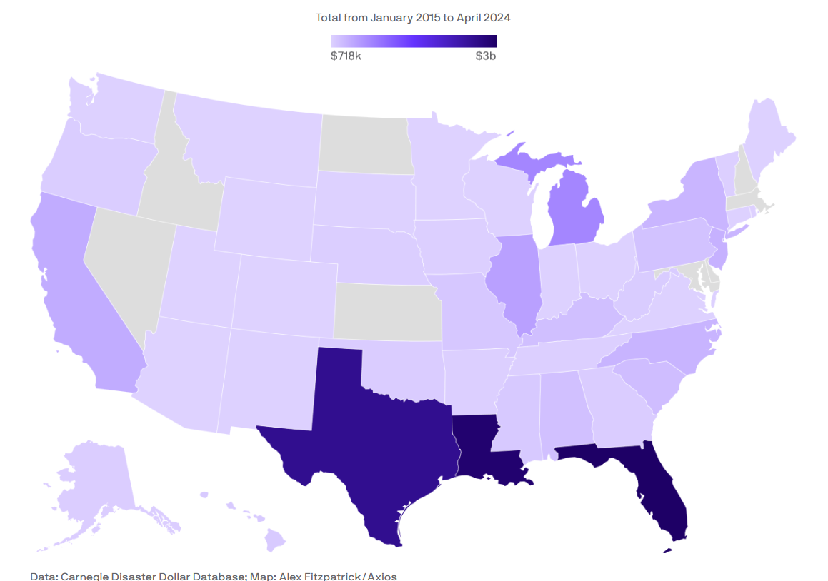
Concluding Thoughts
FEMA expenditures by State (not per capita)
Less catastrophe prone states subsidize more catastrophe prone ones—e.g., residents of Ohio and Indiana subsidize Texas and Florida
Note: Many states with high FEMA expenditures are attracting residents

Slide 31
Concluding Thoughts
Prior two slides demonstrate societal-level moral hazard problem.
To prevent this moral hazard, we would need to let risk-takers fail.
How comfortable are we letting companies fail? How comfortable are we letting individual homes fail?
Federal Insurance; Hamilton’s Paradox

Slide 32
Discussion
Stay in Touch!
Louis.Weimer11@gmail.com
LinkedIn

Slide 33
Works Cited
https://www.nar.realtor/magazine/real-estate-news/states-where-home-insurance-costs-are-surging-highest
St. Louis Federal Reserve
https://fred.stlouisfed.org/series/PCU9241269241262
Mortgage reports:
https://themortgagereports.com/112679/states-surging-home-insurance-costs

